Slide 1
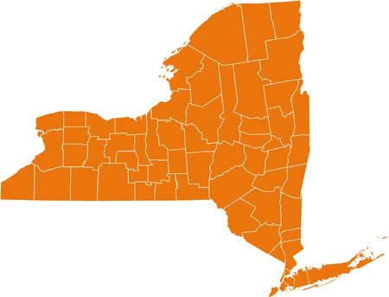
New York State Gender Ratio Prediction
Aastha Agrawal 01
Abhijeet Katiyar 02
Shivaansh Agarwal 24
Mentor:
Ankit Dwivedi Sir

Slide 2
Contents:
Understanding The Business Perspective
Project Overview
Exploratory Data Analysis & Data Cleaning
Why Multiple Regression?
Assumptions regarding Multiple Regression
Model Building & Evaluation
Conclusions
Language Used: R
Packages Used: psych, caTools, ggplot2, car

Slide 3




Understanding
the Business
Perspective

Slide 4
Project Overview (New York State Demographics Dataset)

Slide 5
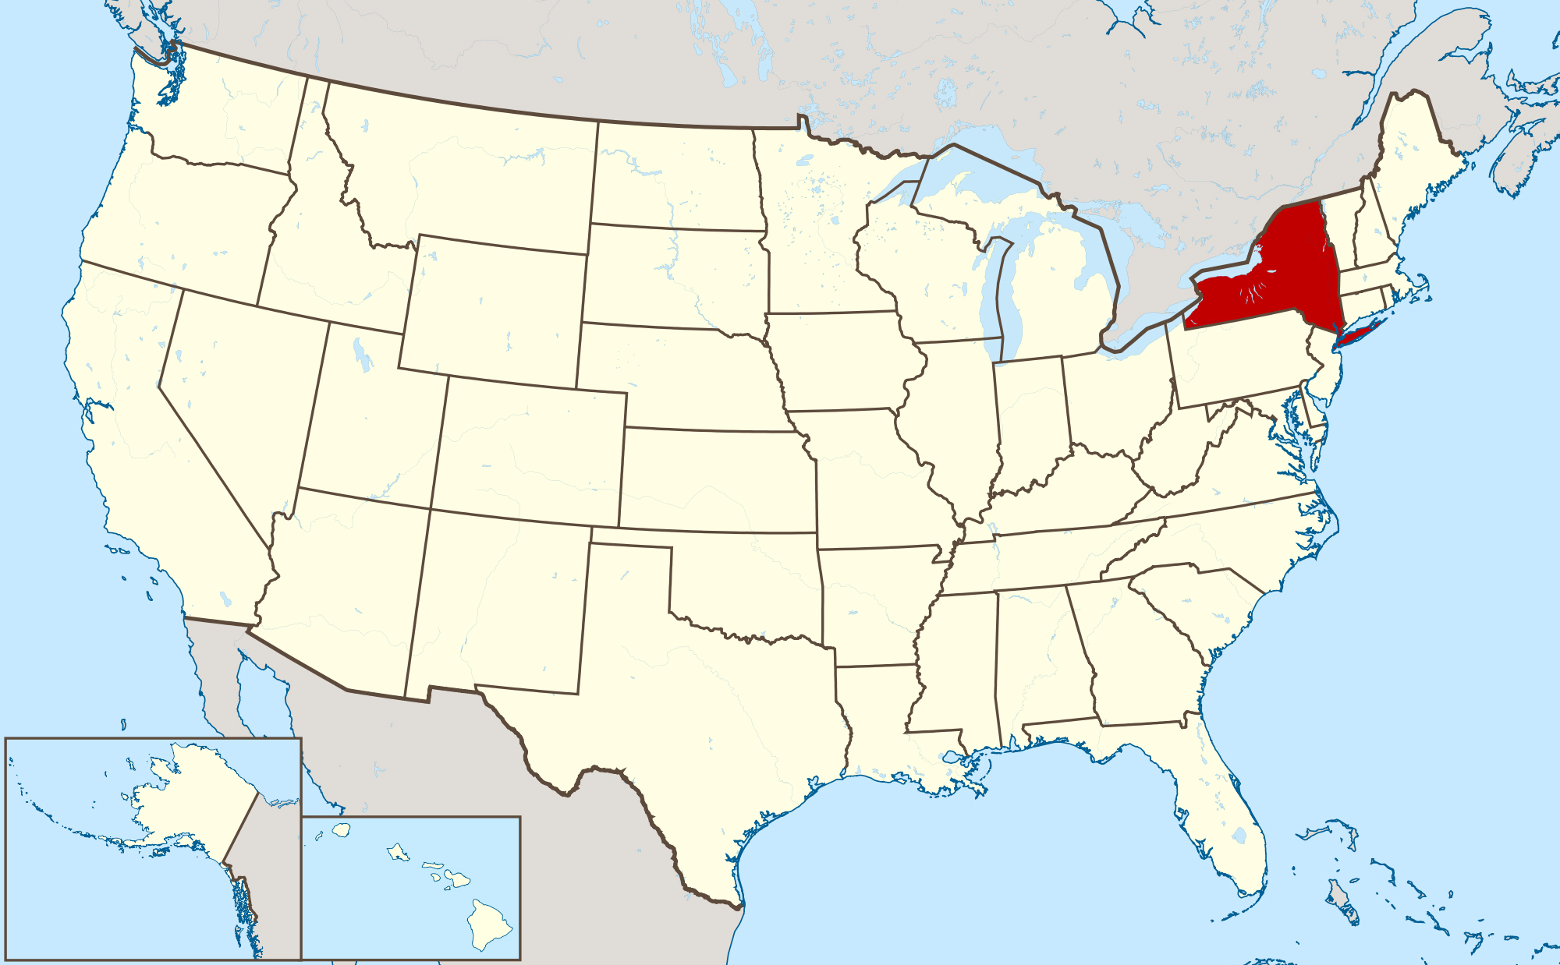
Map of USA highlighting the New York State

Slide 6
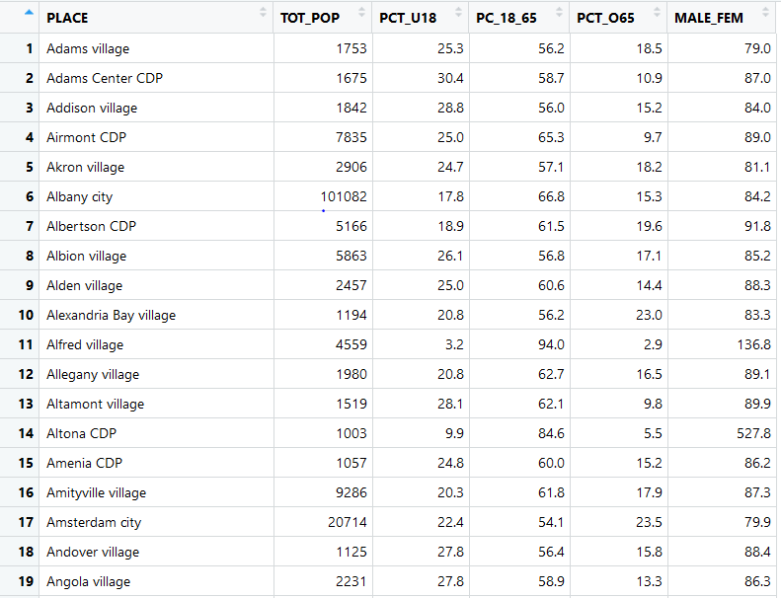

Slide 7
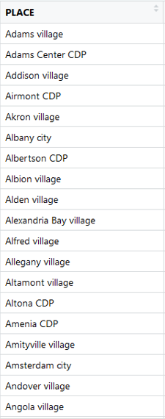
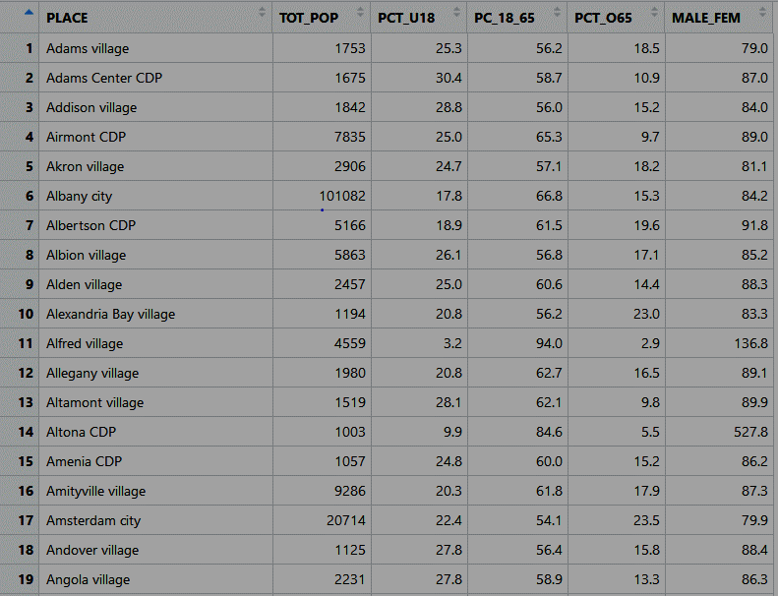

Slide 8


Slide 9


Slide 10


Slide 11
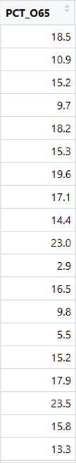

Slide 12
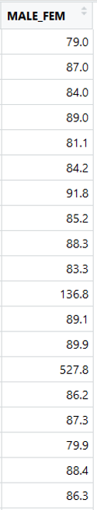

Slide 13


Slide 14
Exploratory
Data Analysis

Slide 15


Count of NA Values and Empty Strings in The Dataset

Slide 16
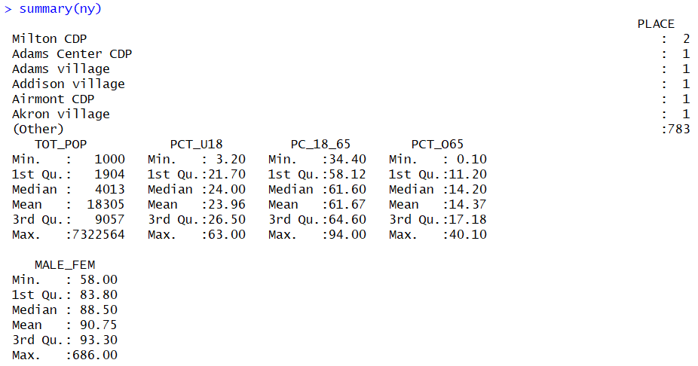
Summary Statistics of the Dataset

Slide 17
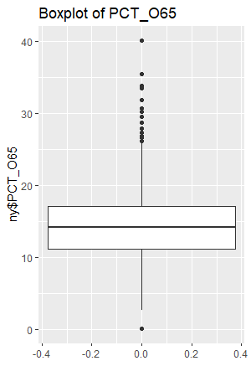
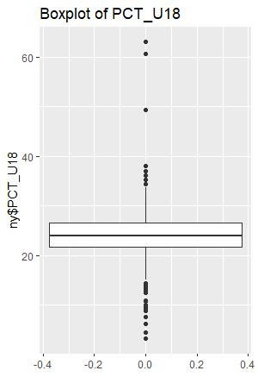
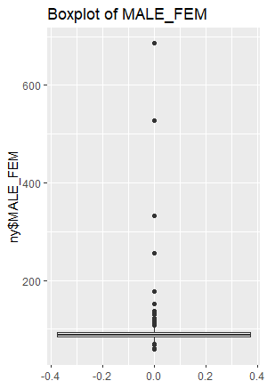
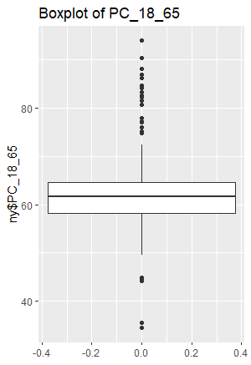
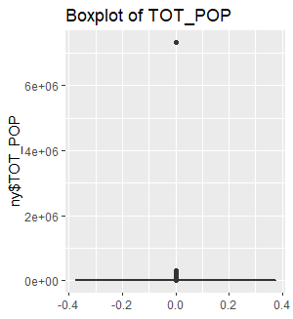
Boxplots of Different Variables in the Dataset

Slide 18
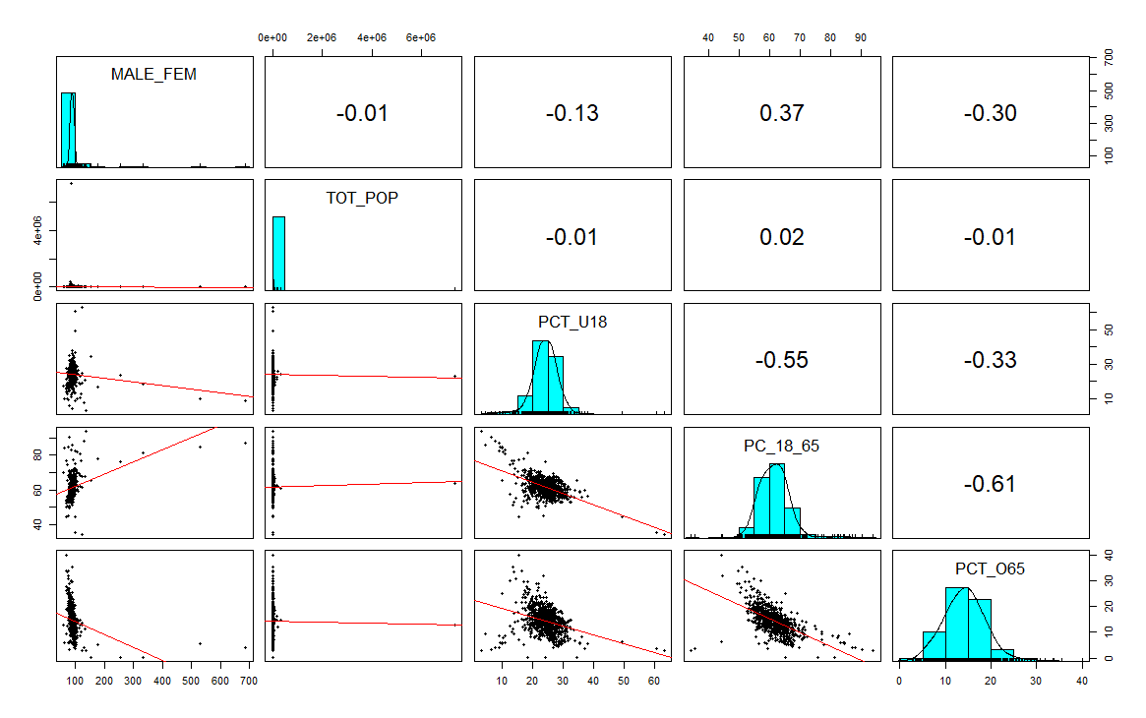
Combination of Scatterplot Matrix, Histograms, Correlation Matrix before Data Cleaning

Slide 19
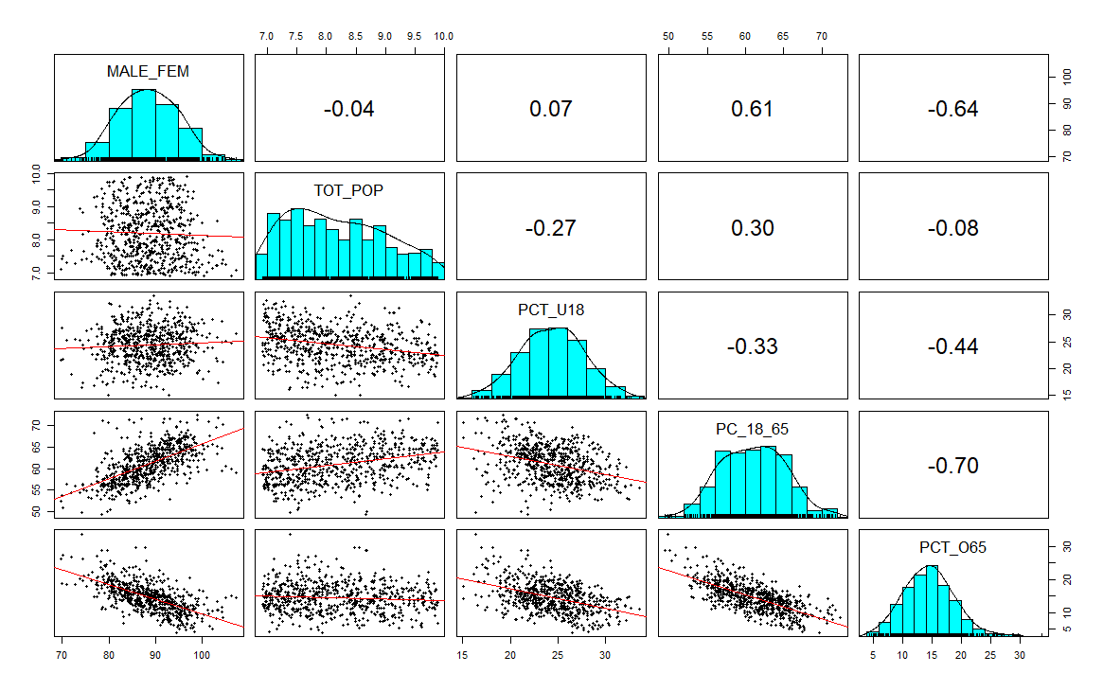
Combination of Scatterplot Matrix, Histograms, Correlation Matrix after Data Cleaning

Slide 20
Why
Multiple Regression ?

Slide 21
Assumptions Regarding Multiple Regression

Slide 22
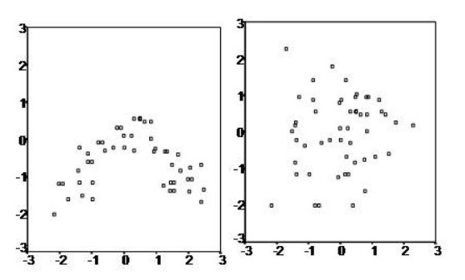
Assumptions Regarding Multiple Regression
LINEAR RELATION between the independent and dependent variables.

Slide 23
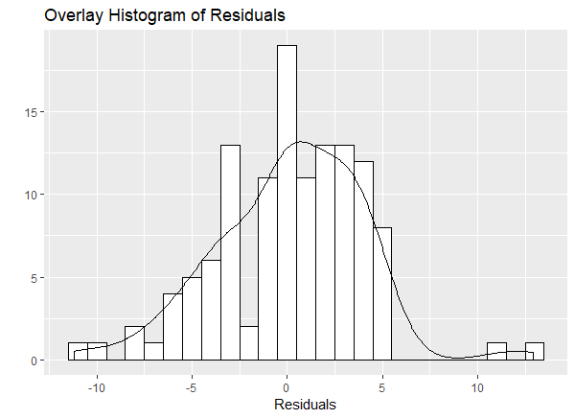
Assumptions Regarding Multiple Regression
LINEAR RELATION between the independent and dependent variables.
Multivariate Normality

Slide 24
Assumptions Regarding Multiple Regression
LINEAR RELATION between the independent and dependent variables.
Multivariate Normality
No Multicollinearity

Slide 25
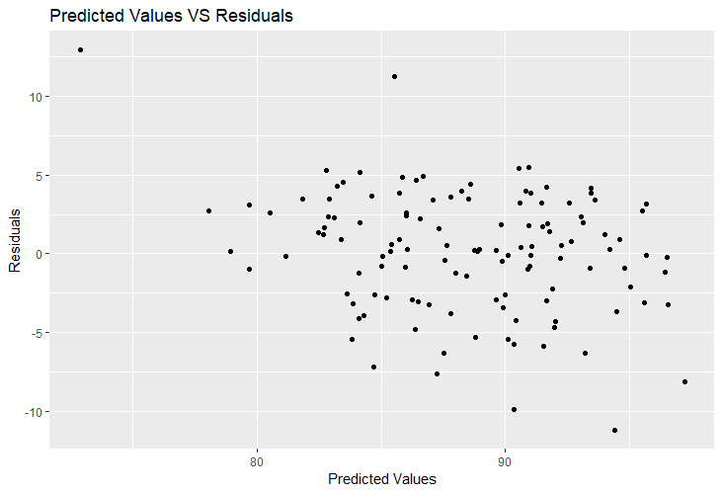
Assumptions Regarding Multiple Regression
LINEAR RELATION between the independent and dependent variables.
Multivariate Normality
No Multicollinearity
Homoscedasticity

Slide 26
Model Building
&
Evaluation

Slide 27
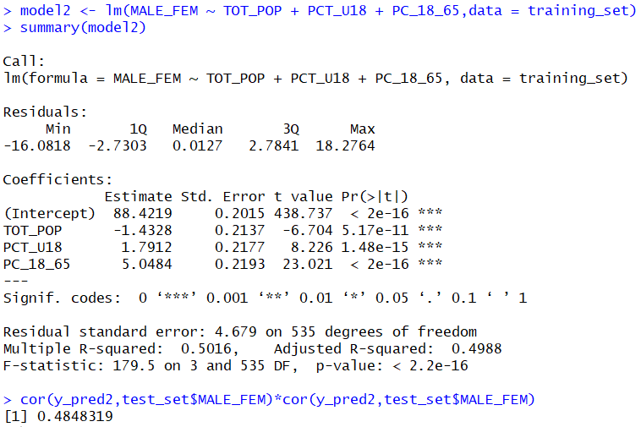

Slide 28
QUESTIONS
Build a regression with "MALE_FEM" as the response and all other variables as the predictors. Explain why the predictor "PCT_o65" is excluded in the model.

Slide 29
QUESTIONS
Build a regression with "MALE_FEM" as the response and all other variables as the predictors. Explain why the predictor "PCT_o65" is excluded in the model.
What is your conclusion regarding the significance of the overall regression?

Slide 30
QUESTIONS
Build a regression with "MALE_FEM" as the response and all other variables as the predictors. Explain why the predictor "PCT_o65" is excluded in the model.
What is your conclusion regarding the significance of the overall regression?
What is the typical error in prediction in the model?
The Residual Standard Error is 4.679 with Error Rate of 5.29%.

Slide 31

QUESTIONS
Build a regression with "MALE_FEM" as the response and all other variables as the predictors. Explain why the predictor "PCT_o65" is excluded in the model.
What is your conclusion regarding the significance of the overall regression?
What is the typical error in prediction in the model?
How many towns are included in the sample?

Slide 32
QUESTIONS
Build a regression with "MALE_FEM" as the response and all other variables as the predictors. Explain why the predictor "PCT_o65" is excluded in the model.
What is your conclusion regarding the significance of the overall regression?
What is the typical error in prediction in the model?
How many towns are included in the sample?
Which of the predictors probably do/does not belong to the model? Explain how you know this. What might be your next step after viewing this results?

Slide 33
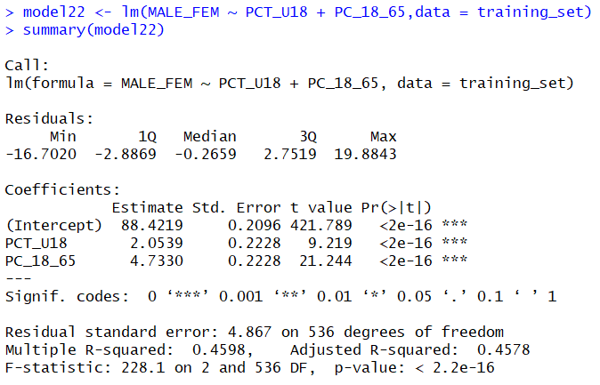
QUESTIONS
Suppose you omit the predictor "TOT_POP" from the model and rerun the regression. Explain what will happen to the value of R-square.

Slide 34


Discuss the presence of multicollinearity. Evaluate the strength of evidence for the presence of multicollinearity. On the basis of this, should you turn to Principal Component Analysis?

Slide 35
QUESTIONS
Clearly and completely express the interpretation for the coefficients for PCT_u18. Discuss whether this makes sense.

Slide 36
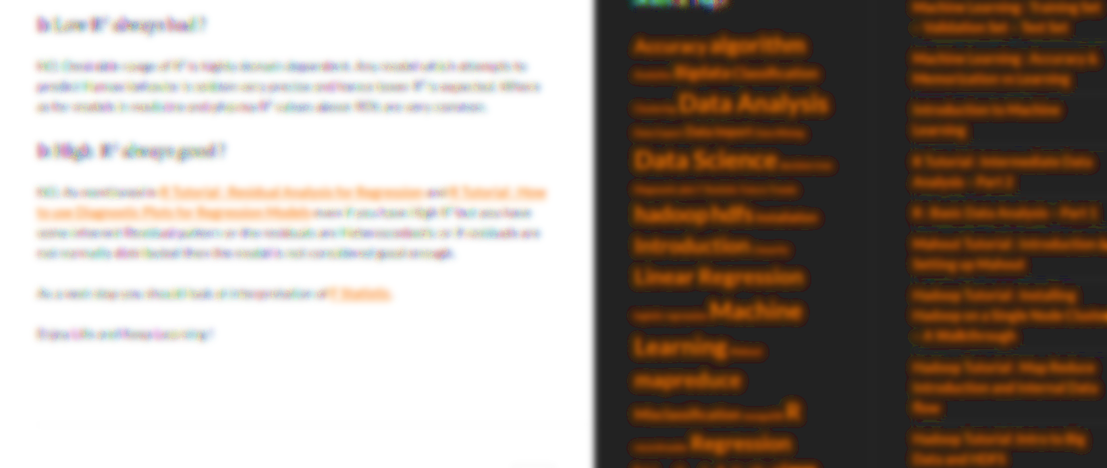
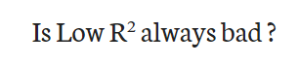
Notes:
http://analyticspro.org/2016/03/14/r-tutorial-interpretation-of-r-squared-and-adjusted-r-squared-in-regression/

Slide 37
Conclusions:

Slide 38
THANK YOU

